Slide 1
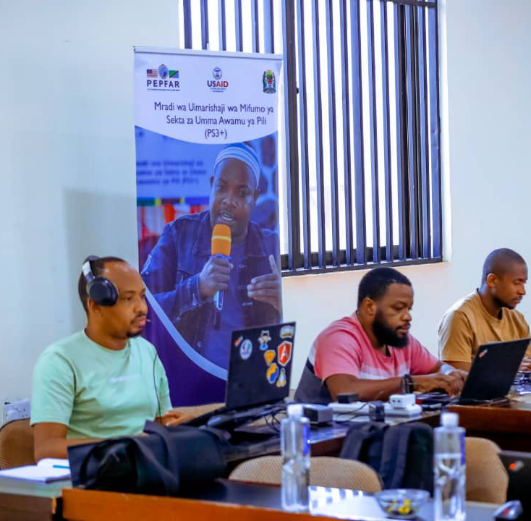
Facility Financial Accounting and Reporting System (FFARS) in Tanzania: successes and challenges
Dr. Gemini Mtei, Deputy Chief of Party
USAID Public Sector Systems Strengthening (PS3+), Abt Global
Policy dialogue: PFM as enabler for greater health facility autonomy, Mauritius, August 27-29, 2024

Slide 2
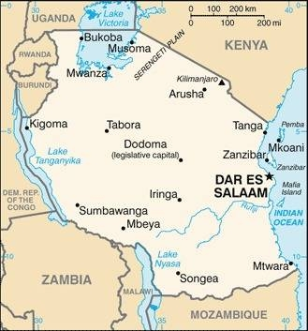
Country Context
Population - 61.7 million
Decentralization by devolution policy
Administration areas as of 2021
  Regions – 26
  Districts - 139
  LGAs -184
  Wards – 3,956
  Village/Mitaa – 16,581
Public Service providers (health and education)
  Public primary health facilities-6,640
  Public schools - 33,980
GDP (Source: WB)– US $ 67.84bn (2021)
GDP growth (Source: WB) – 4.3 (2021)

Slide 3
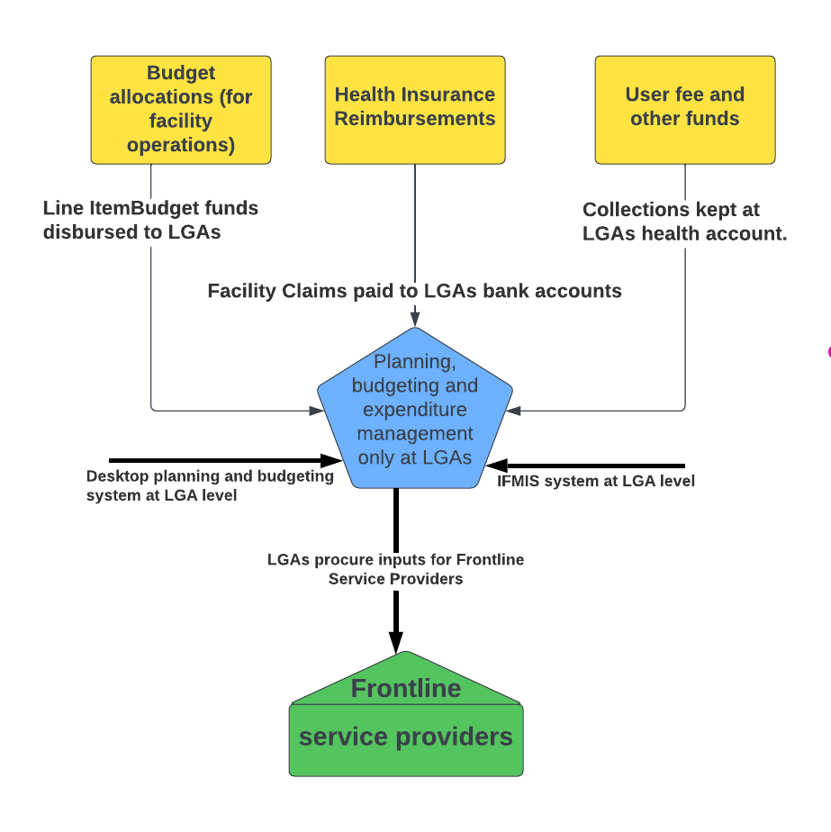
The situation prior to Automation of facility planning, budgeting and financial management
Resources flow only to LGAs
Individual frontline service providers not visible in the PFM systems
  No formal recognition of facilities as fund managers or spending entities
  No health sector budget funds from central Treasury flowing directly and managed by health service providers
Frontline service providers not visible in the PFM system
Notes:
Desktop based planning and budgeting system
Manual budget scrutinization
Planning and budgeting and expenditure management only at LGA level
Planning, budgeting and expenditure management systems not interoperable
Effect: High cost, inefficient service delivery at PHC, frontline service providers not visible

Slide 4
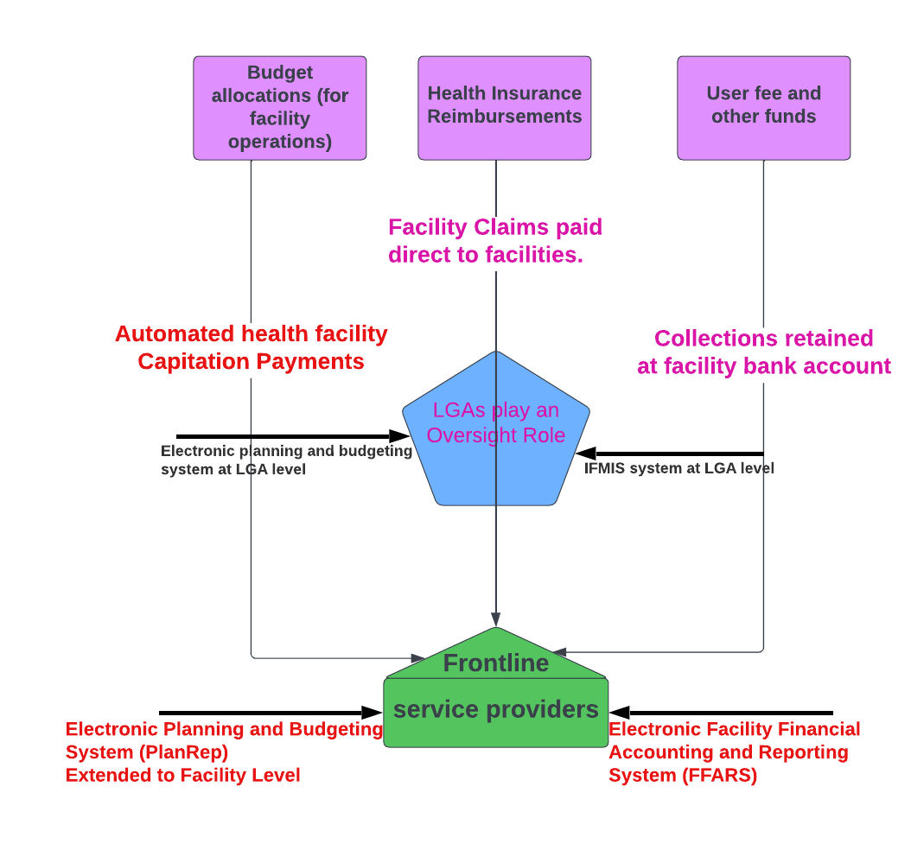
Extending PFM systems to frontline service providers inline with direct facility financing (DFF)…1
In 2017 - introduction of output-based payment to health facilities in central Treasury
  All facilities required to open facility bank account
  Direct Facility Financing (DFF) for Health Sector Basket Fund across all health facilities
  Formula-based payment to service providers (capitation with adjusters for equity, need and performance)
The need to extend PFM systems to facilities to manage DFF

Slide 5
Extending PFM systems to frontline service providers…2
Extending cross-sectoral planning and budgeting system to service provider level to improve service delivery
  PlanRep: system used by LGA for planning, budgeting and reporting
  Chart of Accounts (COA) in PlanRep revised to accommodate individual service provider codes in health and education
  COA also has a code for geographical location and accommodates lower-level governments (villages and wards)
  National Planning and Budget guideline issued by Treasury each year recognizes this new COA that accommodates service providers as planning, budgeting and spending entities
  This gave a formal recognition of service providers as planning, budgeting and spending entities under the national PFM system

Slide 6
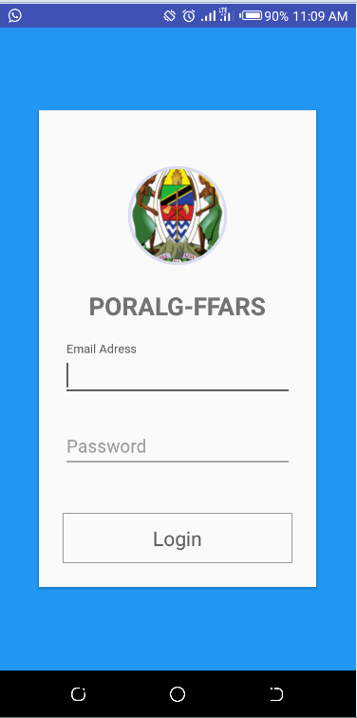
Extending PFM systems to frontline service providers…3
Development of simple web-based Facility Financial Accounting and Reporting System (FFARS)
  Mobile FFARS version developed for place without LAN or computers
Legal frameworks reviewed to recognize health facilities as spending entities
  Local Government Accounting Manual (LAM) revised to recognize FFARS as financial management system at facility level
FFARS:
Capture the funds received and expenditures at the facility level
Provide reports to LGA, Sector Ministry, and Other funders and facility itself
Receive Plans and Budget from PlanRep
Receive COA segments from PlanRep
Send Actual funds received and expensed to PlanRep & MUSE (central IFMIS)

Slide 7
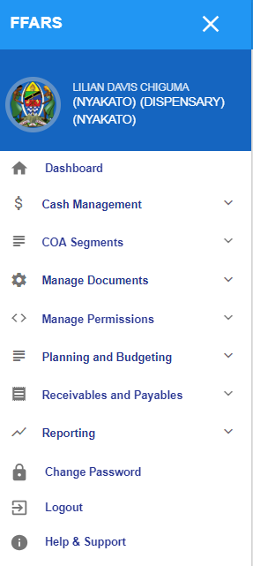
FFARS Modules
Na | Module | Description
1 | “Dashboard” | This is a page that appears when a user click login after entering a User name and Password. A Dashboard will show the amount of funds received, spent and available balance on each facility or level where this user has been assigned to/ has access rights.
2 | “COA Segments” | It’s a module where a user can get all (GFS Codes), “sub-budget class” Fund types, project codes and fund sources. Actually all COA segment come automatically from PlanRep
3 | “Planning and Budgeting” | It’s a module that depicts all plans, activities, activity costing and revenue projections for each facility according to the fund sources. These information are automatically coming from PlanRep
4 | “Receivables and Payables” | This is an important module where a facility uses to recognize all the fund received in its Bank account and the expenditures. It will all receipts, suppliers, customers and payment vouchers The Actual funds received and expenditures will also be exported directly to PlanRep and Epicor
5 | “Cash Management” | This is a module where the management of funds can be done; this includes; Bank reconciliations, journal vouchers, bank adjustment and bank charges etc. And its where you can get bank reconciliation reports
6 | “Reporting” | It’s a module where you can get all reports from the systems; The report varies according to different level of access rights. Facility, Council, Region and PORALG has reports that suits their purposes. Example Cashbook report, general ledger, cash book entries report, income and expenditure reports etc
7 | “Change Password” | A module where a user can change password
8 | “Log out” | A module to logout of the system
9 | “Help and Support” | A module where a user can get online support by going through the FFARS user manual which is access online.
10 | “Settings” | It’s a module for customizing all the settings of the systems. Here only a super user can access this module

Slide 8
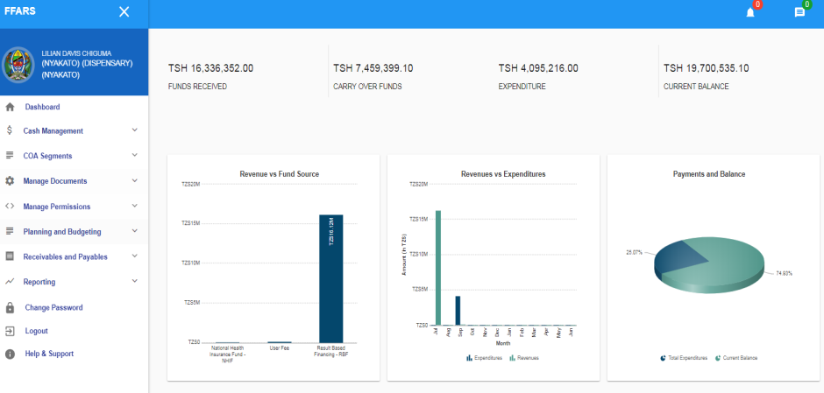
FFARS Dashboard

Slide 9
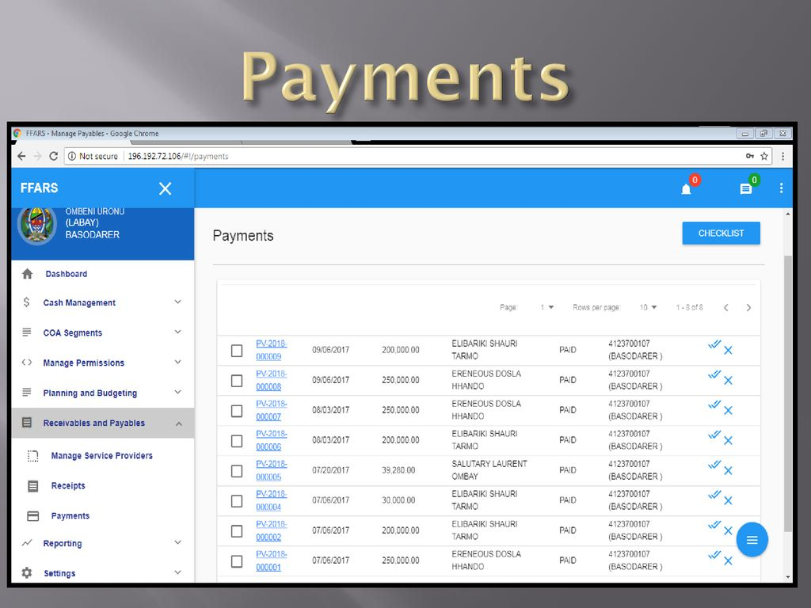
FFARS Usage
FFARS used in:
  176 Council Hospitals,
  5852 Dispensaries,
  841 Health Center,
  17707 Primary School,
  4786 Secondary School,
  9132 Villages/Mtaa,
  2043 Wards
  100,788 users

Slide 10

FFARS development process
Using local programmers and system analysts
Blue rooms approach
Followed Agile Methodology in development
Clear Governance structure
Continuous improvements/refinements based on user feedback and additional/new requirements
Training
  National Trainers of Trainers
  End user training (Cascading approach)

Slide 11
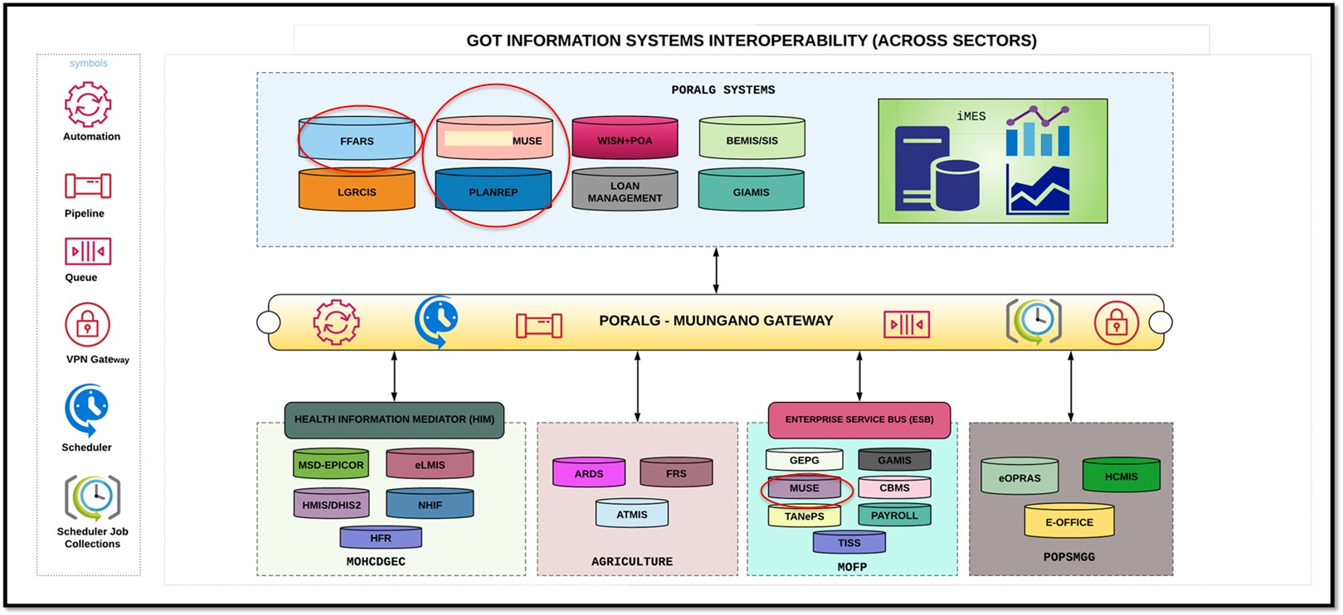
Systems Interoperability

Slide 12
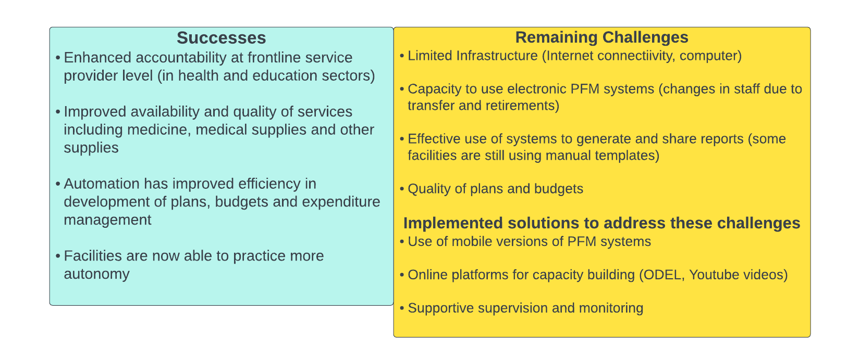
Successes and Remaining Challenges
Article: Performance Assessment of FFARS: https://pubmed.ncbi.nlm.nih.gov/36925885/
Documentary: FFARS improves Citizens Engagement and public service delivery: https://www.youtube.com/watch?v=oQ9ApAk5vzA
Link to FFARS Tutorial: https://www.youtube.com/watch?v=UXMrqMDWrIg&list=PL2KOBpskLinT1SEmDIeKmOiB6A0qaODi7

Slide 13

Thank you

