Slide 1
Balancing control and flexibility for fiscal control and service delivery: the role of technology
Moritz Piatti-Fünfkirchen
Senior Economist, World Bank
Notes:
Government expenditure data is central to reorient spending
What we want to get into, is where data come from, what does it mean, and what is the actual utility of it.

Slide 2
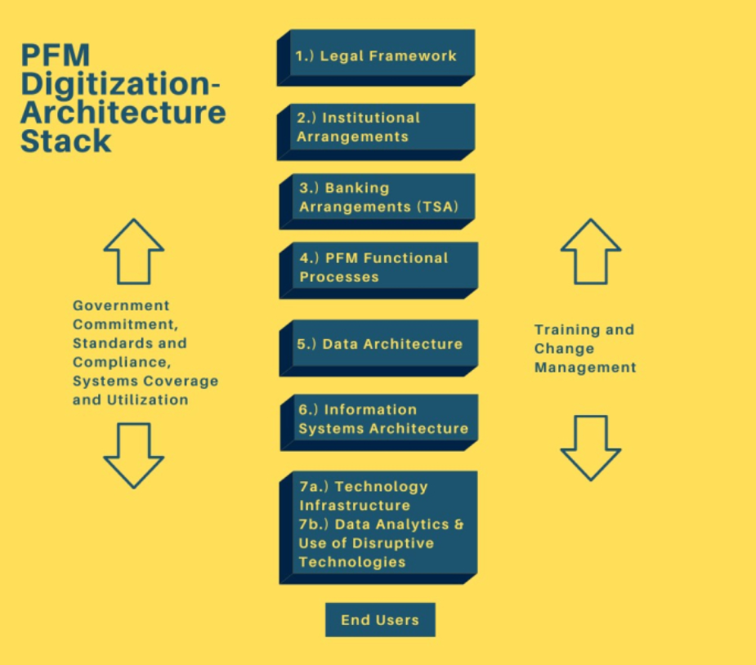
A Stacked Layer Model Approach to PFM Digitization
Where does technology come in? where not?
Why does it matter?
How can it affect expenditure control and service delivery?
Source: IMF. 2020. Stacked Layer Approach to PFM Digitization

Slide 3
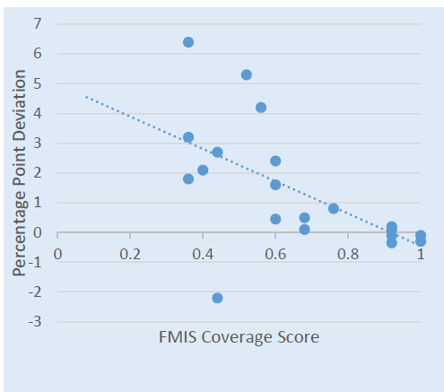
FMIS for Expenditure Control Requires Utilization
FMIS utilization and deviation from planned deficit
What is the marginal impact of FMIS investments?
How does it support expenditure control?
How does it support service delivery?
Take a data driven approach to assess FMIS effectiveness
Leverage technology for decision making
Source:
Piatti-Fünfkirchen et al (2017).
Hashim et al (2020).

Slide 4
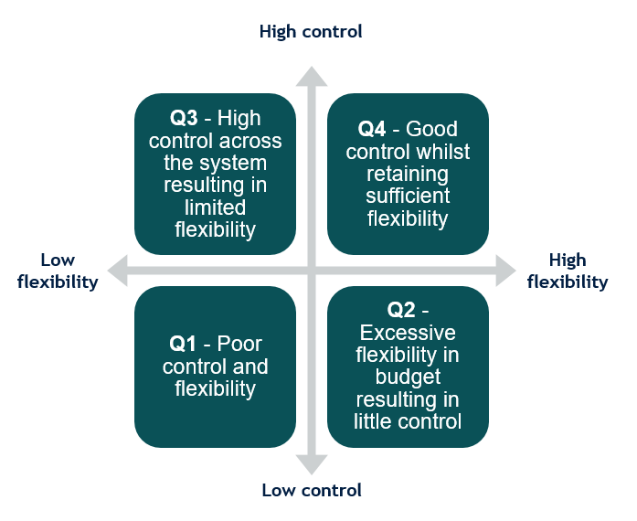
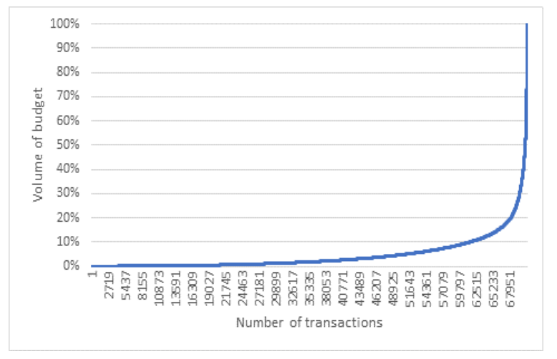
Take a Risk-Based Approach to Expenditure Management
Source:
Hashim, A., et al. 2019. The Use of Data Analytics Techniques to Assess the Functioning of a Government's Financial Management Information System: An Application to Pakistan and Cambodia.

Slide 5
Take Advantage of Maturing Technologies to Foster Efficiency, Reach and Accountability in Service Delivery
Examples from the health sector
Blockchain for verification of services
What services were delivered?
What outputs achieved?
Who received services?
Confidence in data providence
→ Inform budget allocation decisions
Use of mobile money to initiate payment
Facilitate G2G transfers to remote providers
Digitization of transactions
Improved cash management
Improved facility autonomy
→ Efficiency and accountability
Source:
World Bank. 2019. Balancing control and flexibility: using banking sector innovations for improved expenditure control and effective service delivery.

Slide 6
References
Hashim, A., et al. 2019. The Use of Data Analytics Techniques to Assess the Functioning of a Government's Financial Management Information System: An Application to Pakistan and Cambodia. World Bank Policy Research Working Paper; No. WPS 8689. Washington, D.C.: World Bank Group.
Hashim, A. and M. Piatti-Fünfkirchen. 2018. Lessons From Reforming Financial Management Information Systems: A Review of the Evidence. World Bank Policy Research Working Paper; No. WPS 8312. Washington, D.C.: World Bank Group.
Hashim, A. and M. Piatti-Fünfkirchen. 2016. A Diagnostic Framework to Assess the Capacity of a Government's Financial Management Information System as a Budget Management Tool. IEG Working Paper
Piatti-Fünfkirchen, M. and A. Hashim. 2020. A Stacked Layer Approach to PFM Digitization. International Monetary Fund
Piatti-Fünfkirchen M. et al. 2019. Balancing control and flexibility in public expenditure management: using banking sector innovations for improved expenditure control and effective service delivery. Policy Research Working Paper; No. 9029. World Bank, Washington, DC. © World Bank.
Piatti-Fünfkirchen, M. and A. Hashim. 2017. Using Financial Management Information Systems (FMIS) for Fiscal Control: Applying a Risk-Based Approach for Early Results in the Reform Process. IPMN Conference paper.

Slide 7
Thank you

